Slide 1


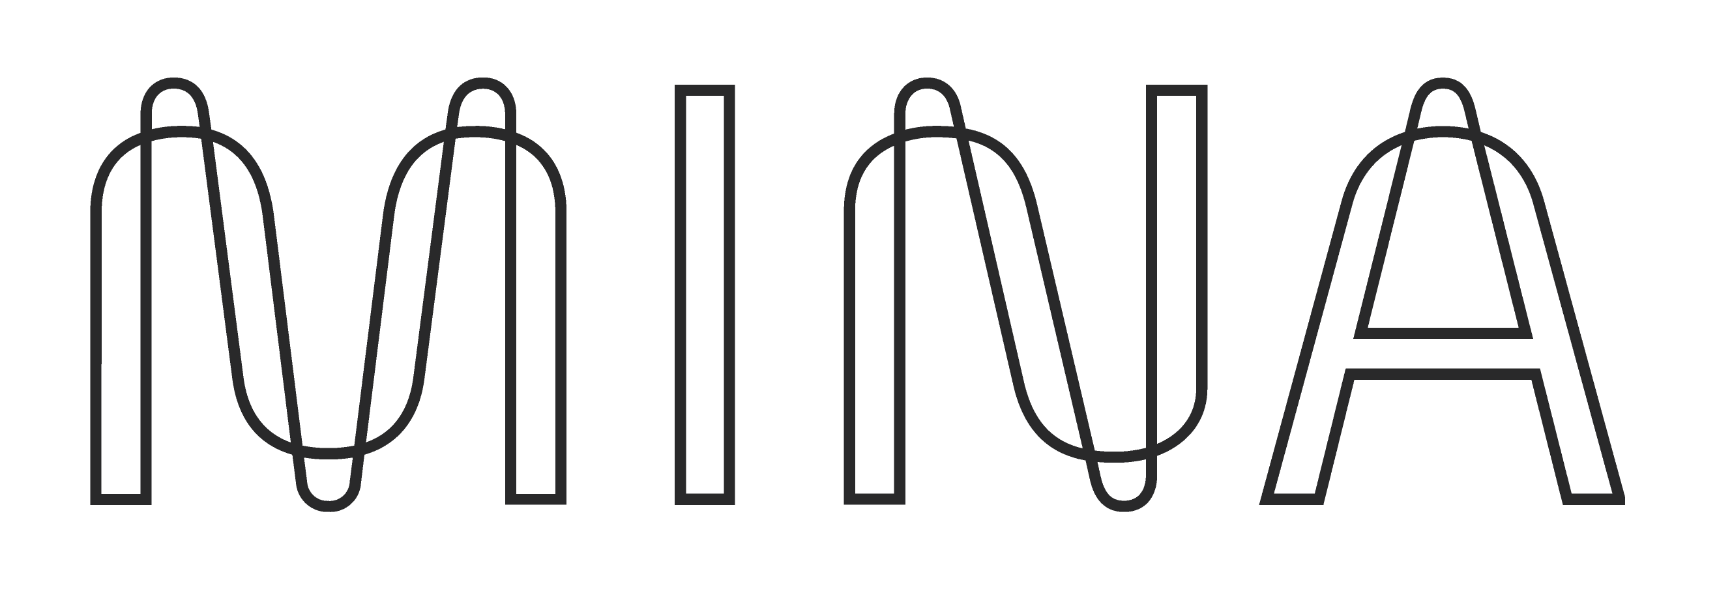
Naamah Mina Stake
THE LIGHTEST PROOF OF EVERYTHING BLOCKCHAIN

Slide 2
